Slide 1
Source-Term Determination of Radionuclide Releases by Inverse
Atmospheric Dispersion Modelling (STRADI)
Czech-Norwegian Research Programme CZ09
Václav Šmídl, Nikolaos Evangeliou
8th November, 2016
Prague

Slide 2


Project consortium
Institute of Information Theory and Automation
Norwegian Institute of Air Research
Complementary expertise:
  inverse modeling (ÚTIA),
  atmospheric modeling (NILU)
Collaboration on inverse modeling of radiation releases into atmosphere.
  Better methods for scientists and radiation protection institutions
Future work on parameter optimization, model calibration, etc.

Slide 3
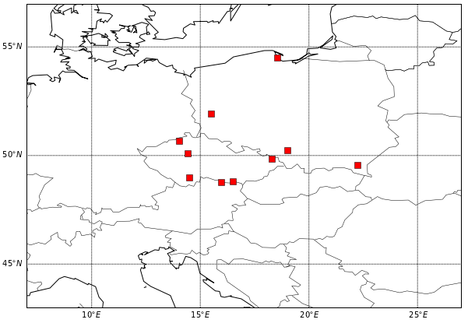
Why is project needed?
In the fall of 2011, low concentration of I-131 was detected in the atmosphere by the European Trace Survey Stations Network for Monitoring Airborne Radioactivity (Ro5)
After detection in Austria, Czech Republic and other countries followed.
What happened?
Is it serious?
What will be the consequences?
Chernobyl & Fukushima??

Slide 4
What are the project‘s objectives?
Develop methods of source term determination (when a how much of radiation was released) from a wide range of measurement types: concentrations, gamma dose, deposition.
Develop statistical methods for quantification of uncertainty and elimination of tuning parameters.
Test on existing data from tracer experiments, and collect new information for reevaluation of events (e.g. Chernobyl, Fukushima).
Test the methods on different type of data, such as volcanic ash (Eyjafjallajökull, Iceland, 2010).

Slide 5
What is the project expected to achieve?
New mathematical and statistical methods
  Publication in mathematical and statistical journals
  Publication of their application in environmental protection journals
Re-analysis of historical release events in the light of new methods and new data.
Software that can be used by other researchers and environment protection institutions:
  Czech authorities (SÚRO, SÚJB), German (BfS), etc.
  Volcanic ash committee,
  Comprehensive Nuclear Test Ban Treaty Organization (CTBTO)

Slide 6
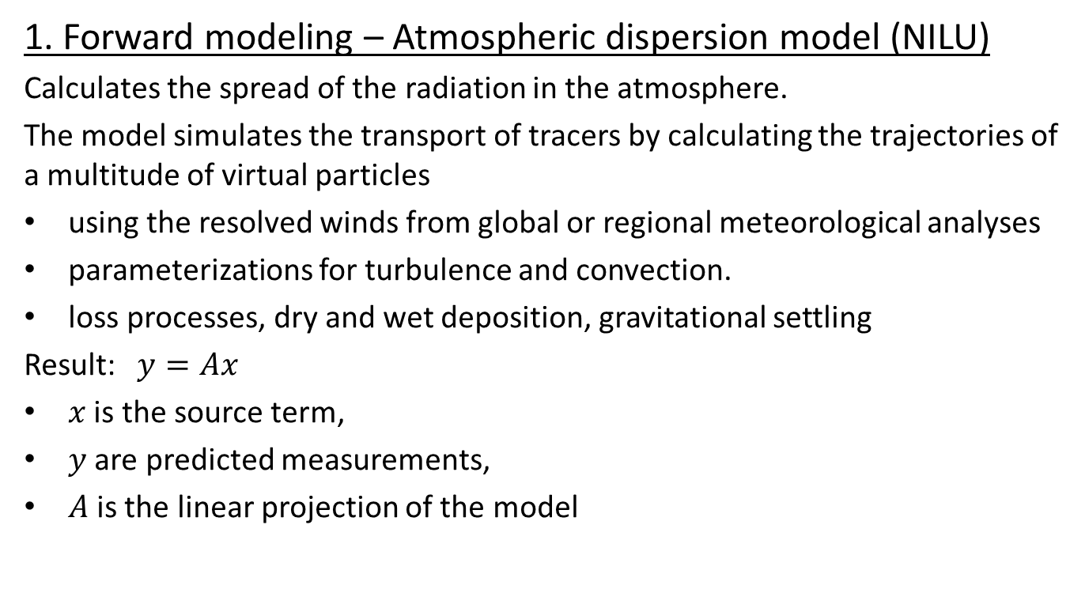
How are you going to address these challenges?
1. Forward modeling – Atmospheric dispersion model (NILU)
Calculates the spread of the radiation in the atmosphere.
The model simulates the transport of tracers by calculating the trajectories of a multitude of virtual particles
using the resolved winds from global or regional meteorological analyses
parameterizations for turbulence and convection.
loss processes, dry and wet deposition, gravitational settling
Result:
is the source term,
are predicted measurements,
is the linear projection of the model

Slide 7
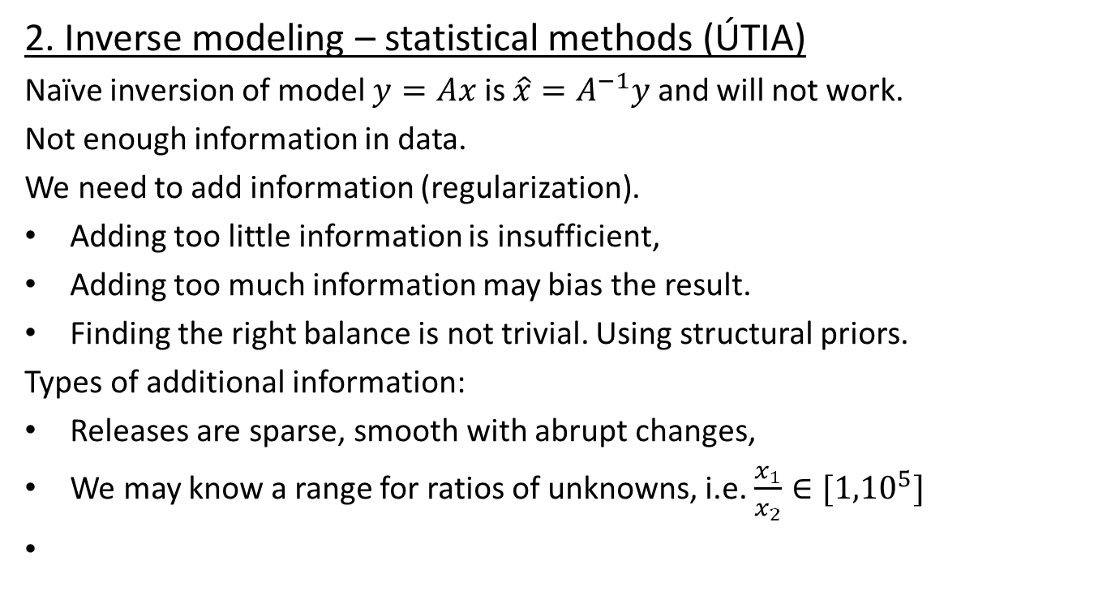
How are you going to address these challenges?
2. Inverse modeling – statistical methods (ÚTIA)
Naïve inversion of model is and will not work.
Not enough information in data.
We need to add information (regularization).
Adding too little information is insufficient,
Adding too much information may bias the result.
Finding the right balance is not trivial. Using structural priors.
Types of additional information:
Releases are sparse, smooth with abrupt changes,
We may know a range for ratios of unknowns, i.e.

Slide 8
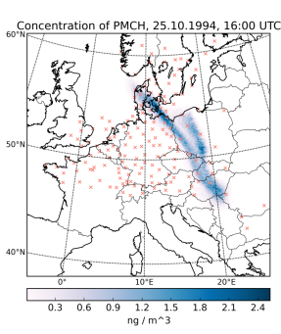
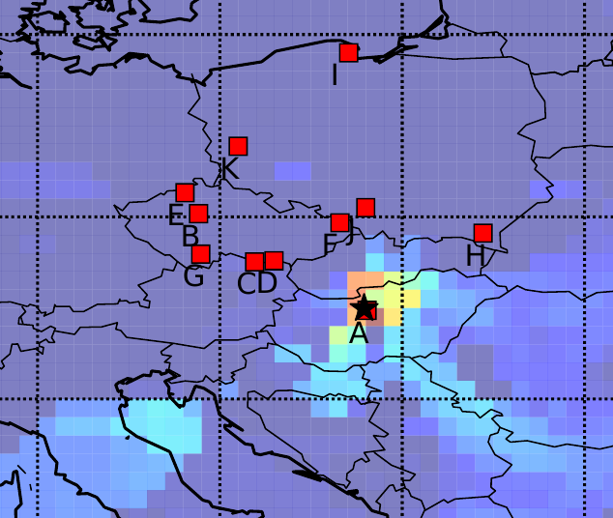
Applications
Tests and validation of real dataset
The European tracer experiment, | I131 release from 2011

Slide 9
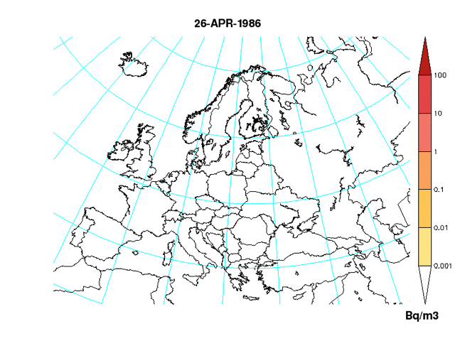
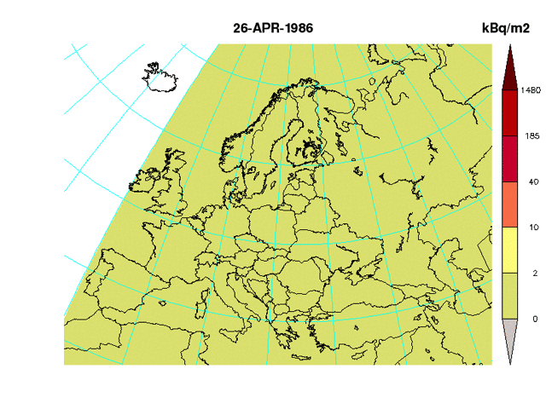
Applications (Chernobyl)
Activity concentration
Accumulated deposition

Slide 10
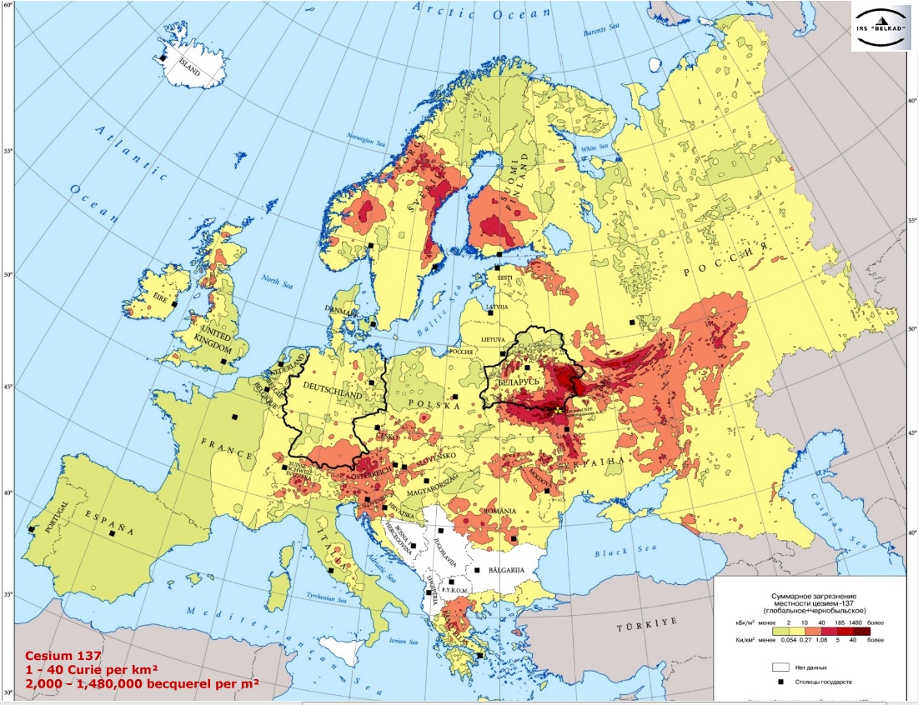
Applications (a. data rescue)
Station data used IDW interpolation
WHERE ARE THEY? HAS ANYBODY EVER SEEN THEM?
De Cort et al., 1998. JRC

Slide 11
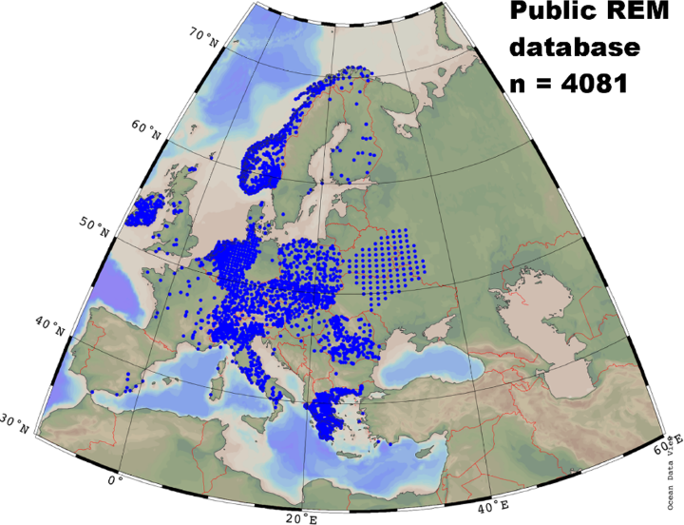
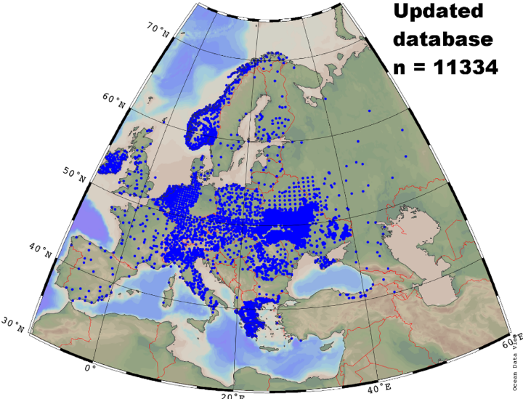
Applications (a. data rescue)
Online data Our enrichment
Evangeliou et al., 2016. Environmental Pollution

Slide 12
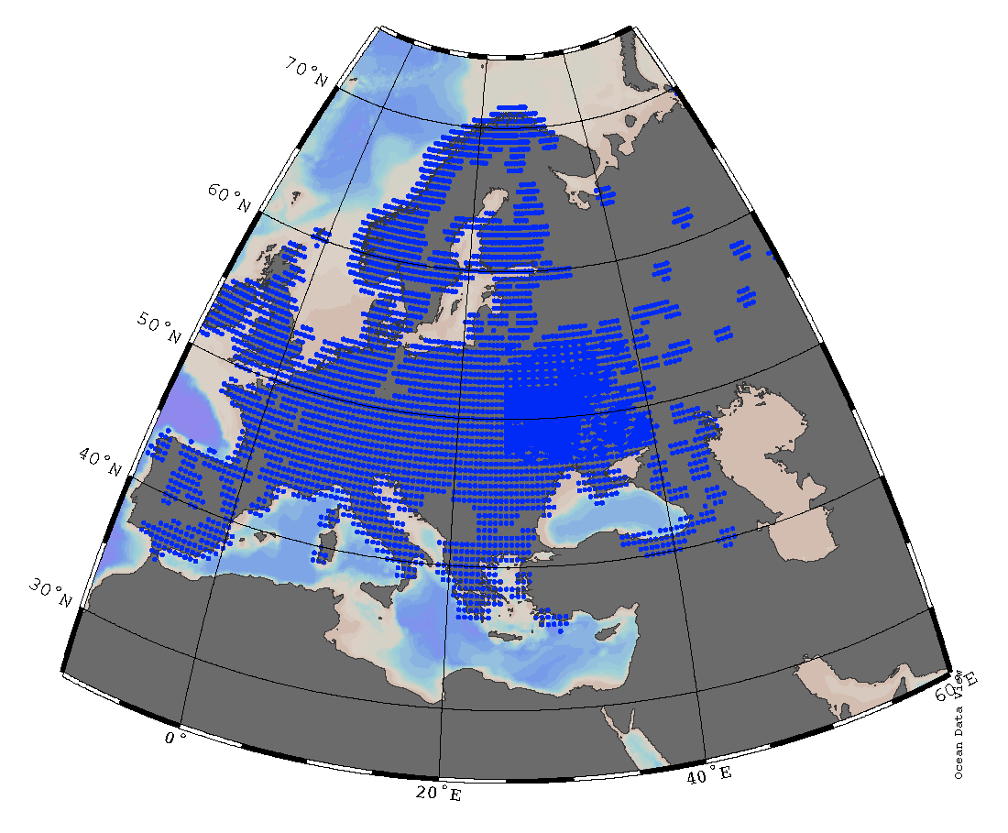
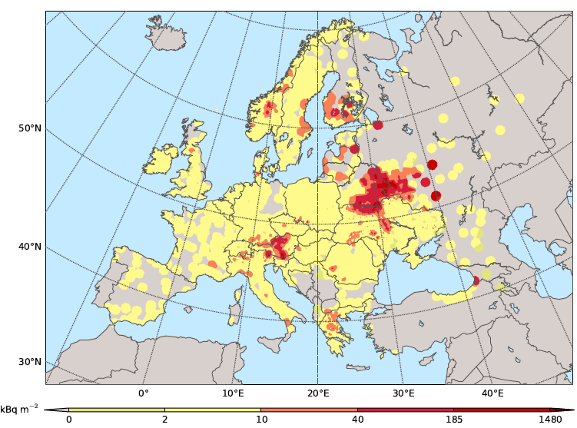
Applications (a. data rescue)
0.1 deg outside CEZ
0.01 inside CEZ
Evangeliou et al., 2016. Environmental Pollution

Slide 13
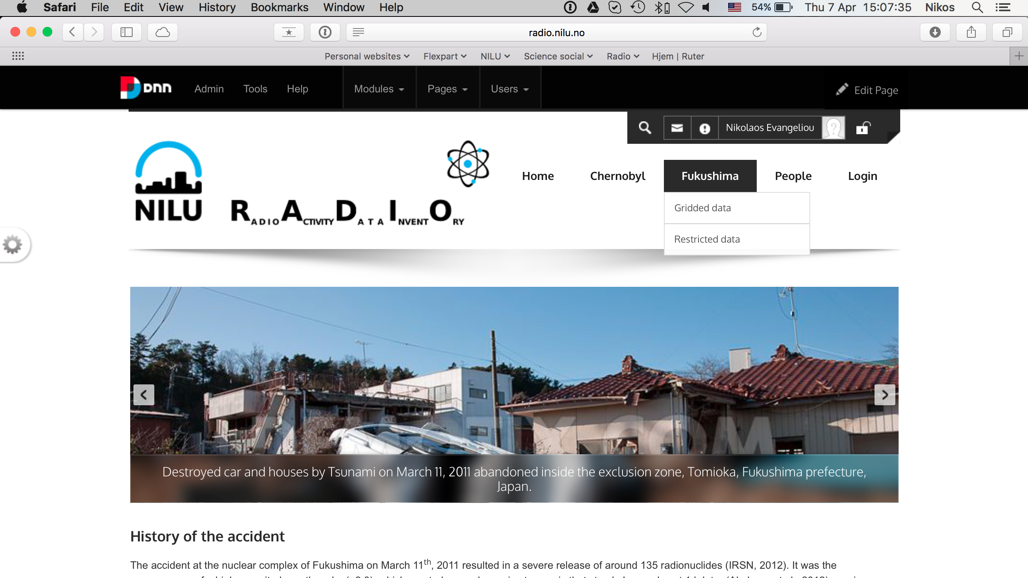
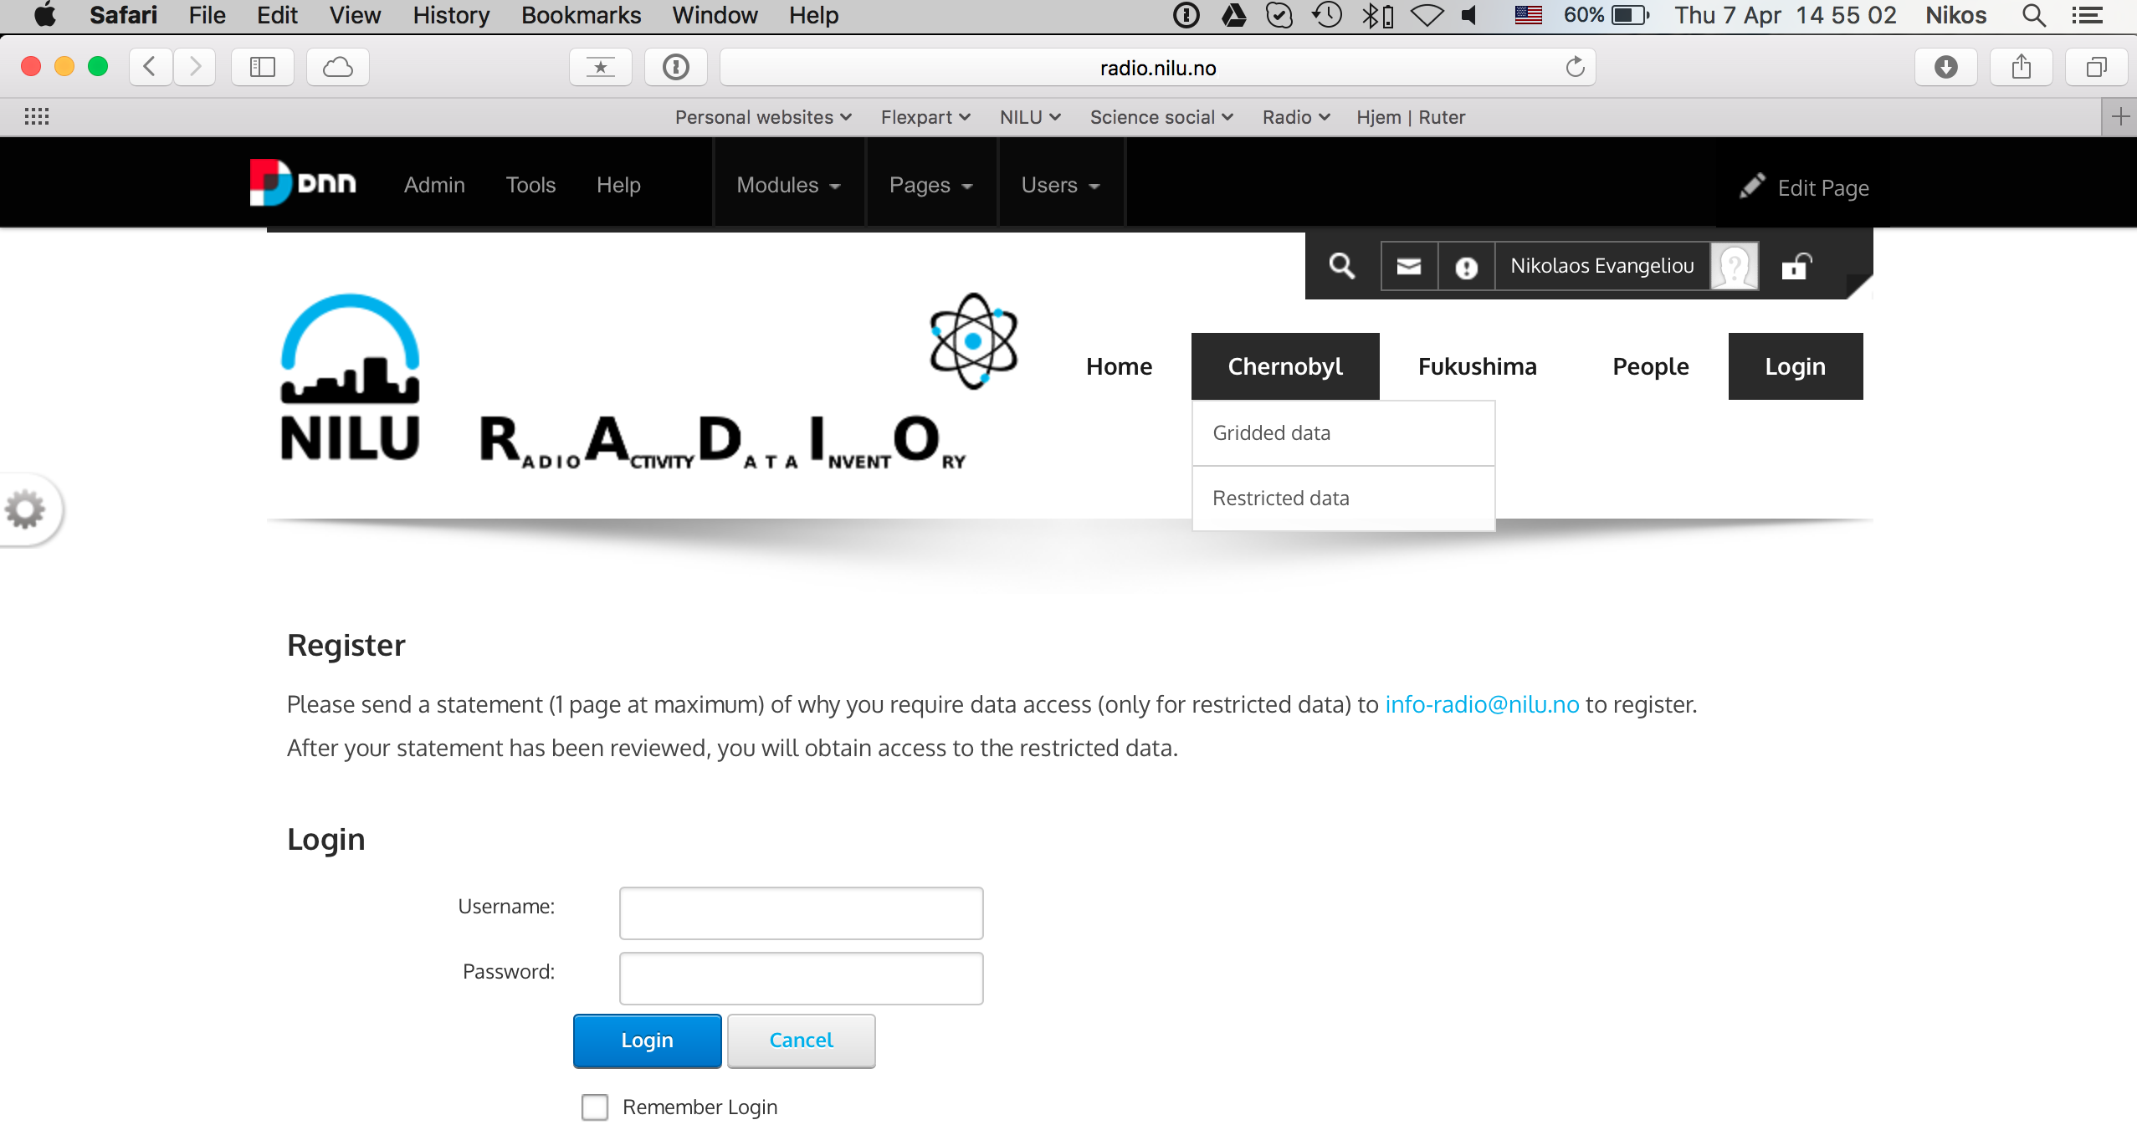
Applications (a. data rescue)

Slide 14
Applications (b. source-term)
135 PBq instead of 85 PBq (prior)

Slide 15
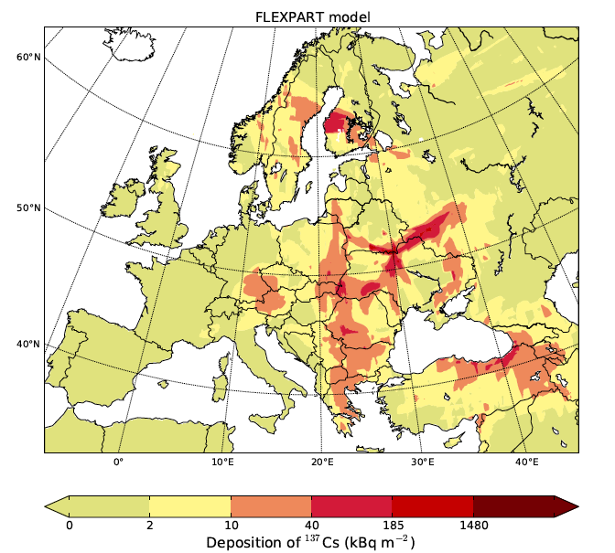
Applications (b. source-term)

Slide 16
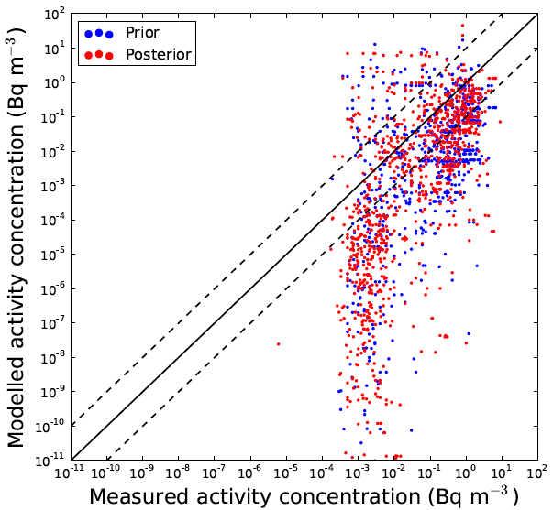
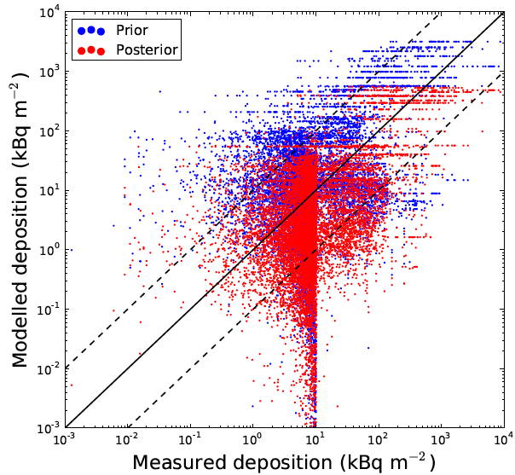
Applications (b. source-term)

Slide 17
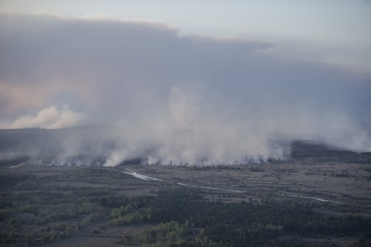
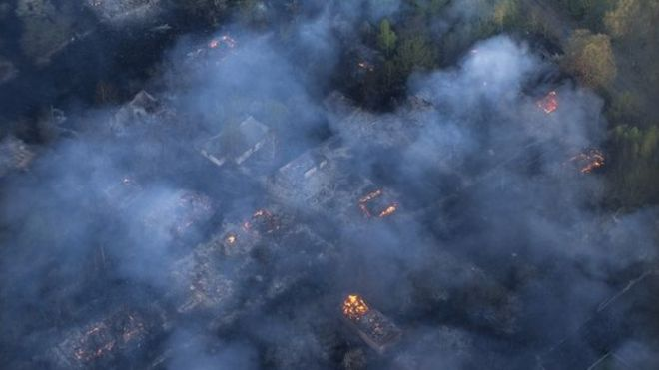
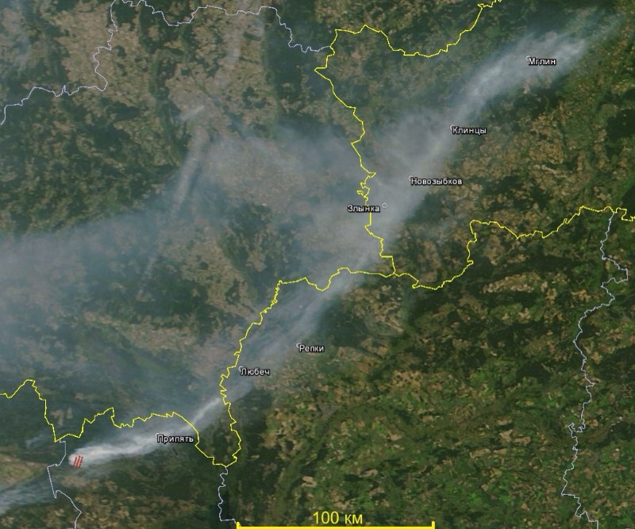
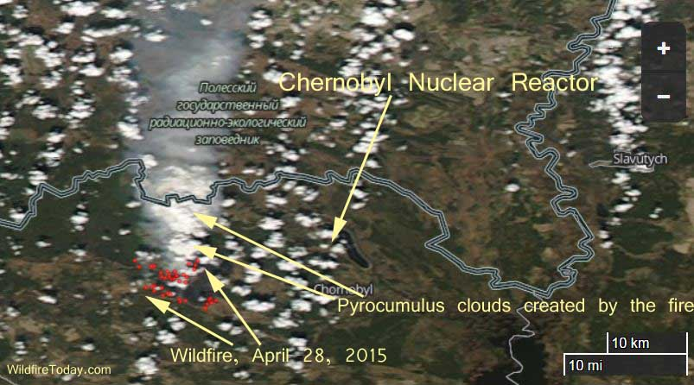
Applications (c. 2015 fires)
April–May fires
August fires

Slide 18
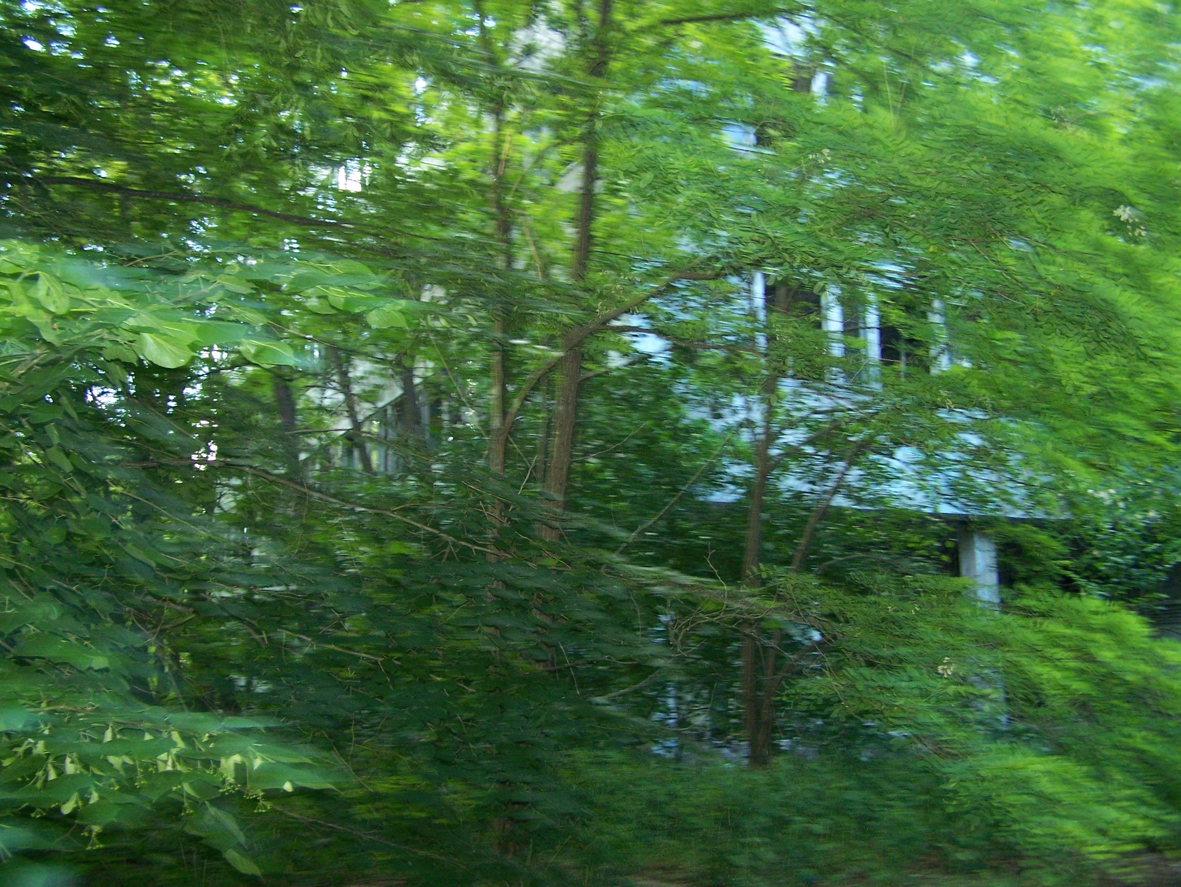
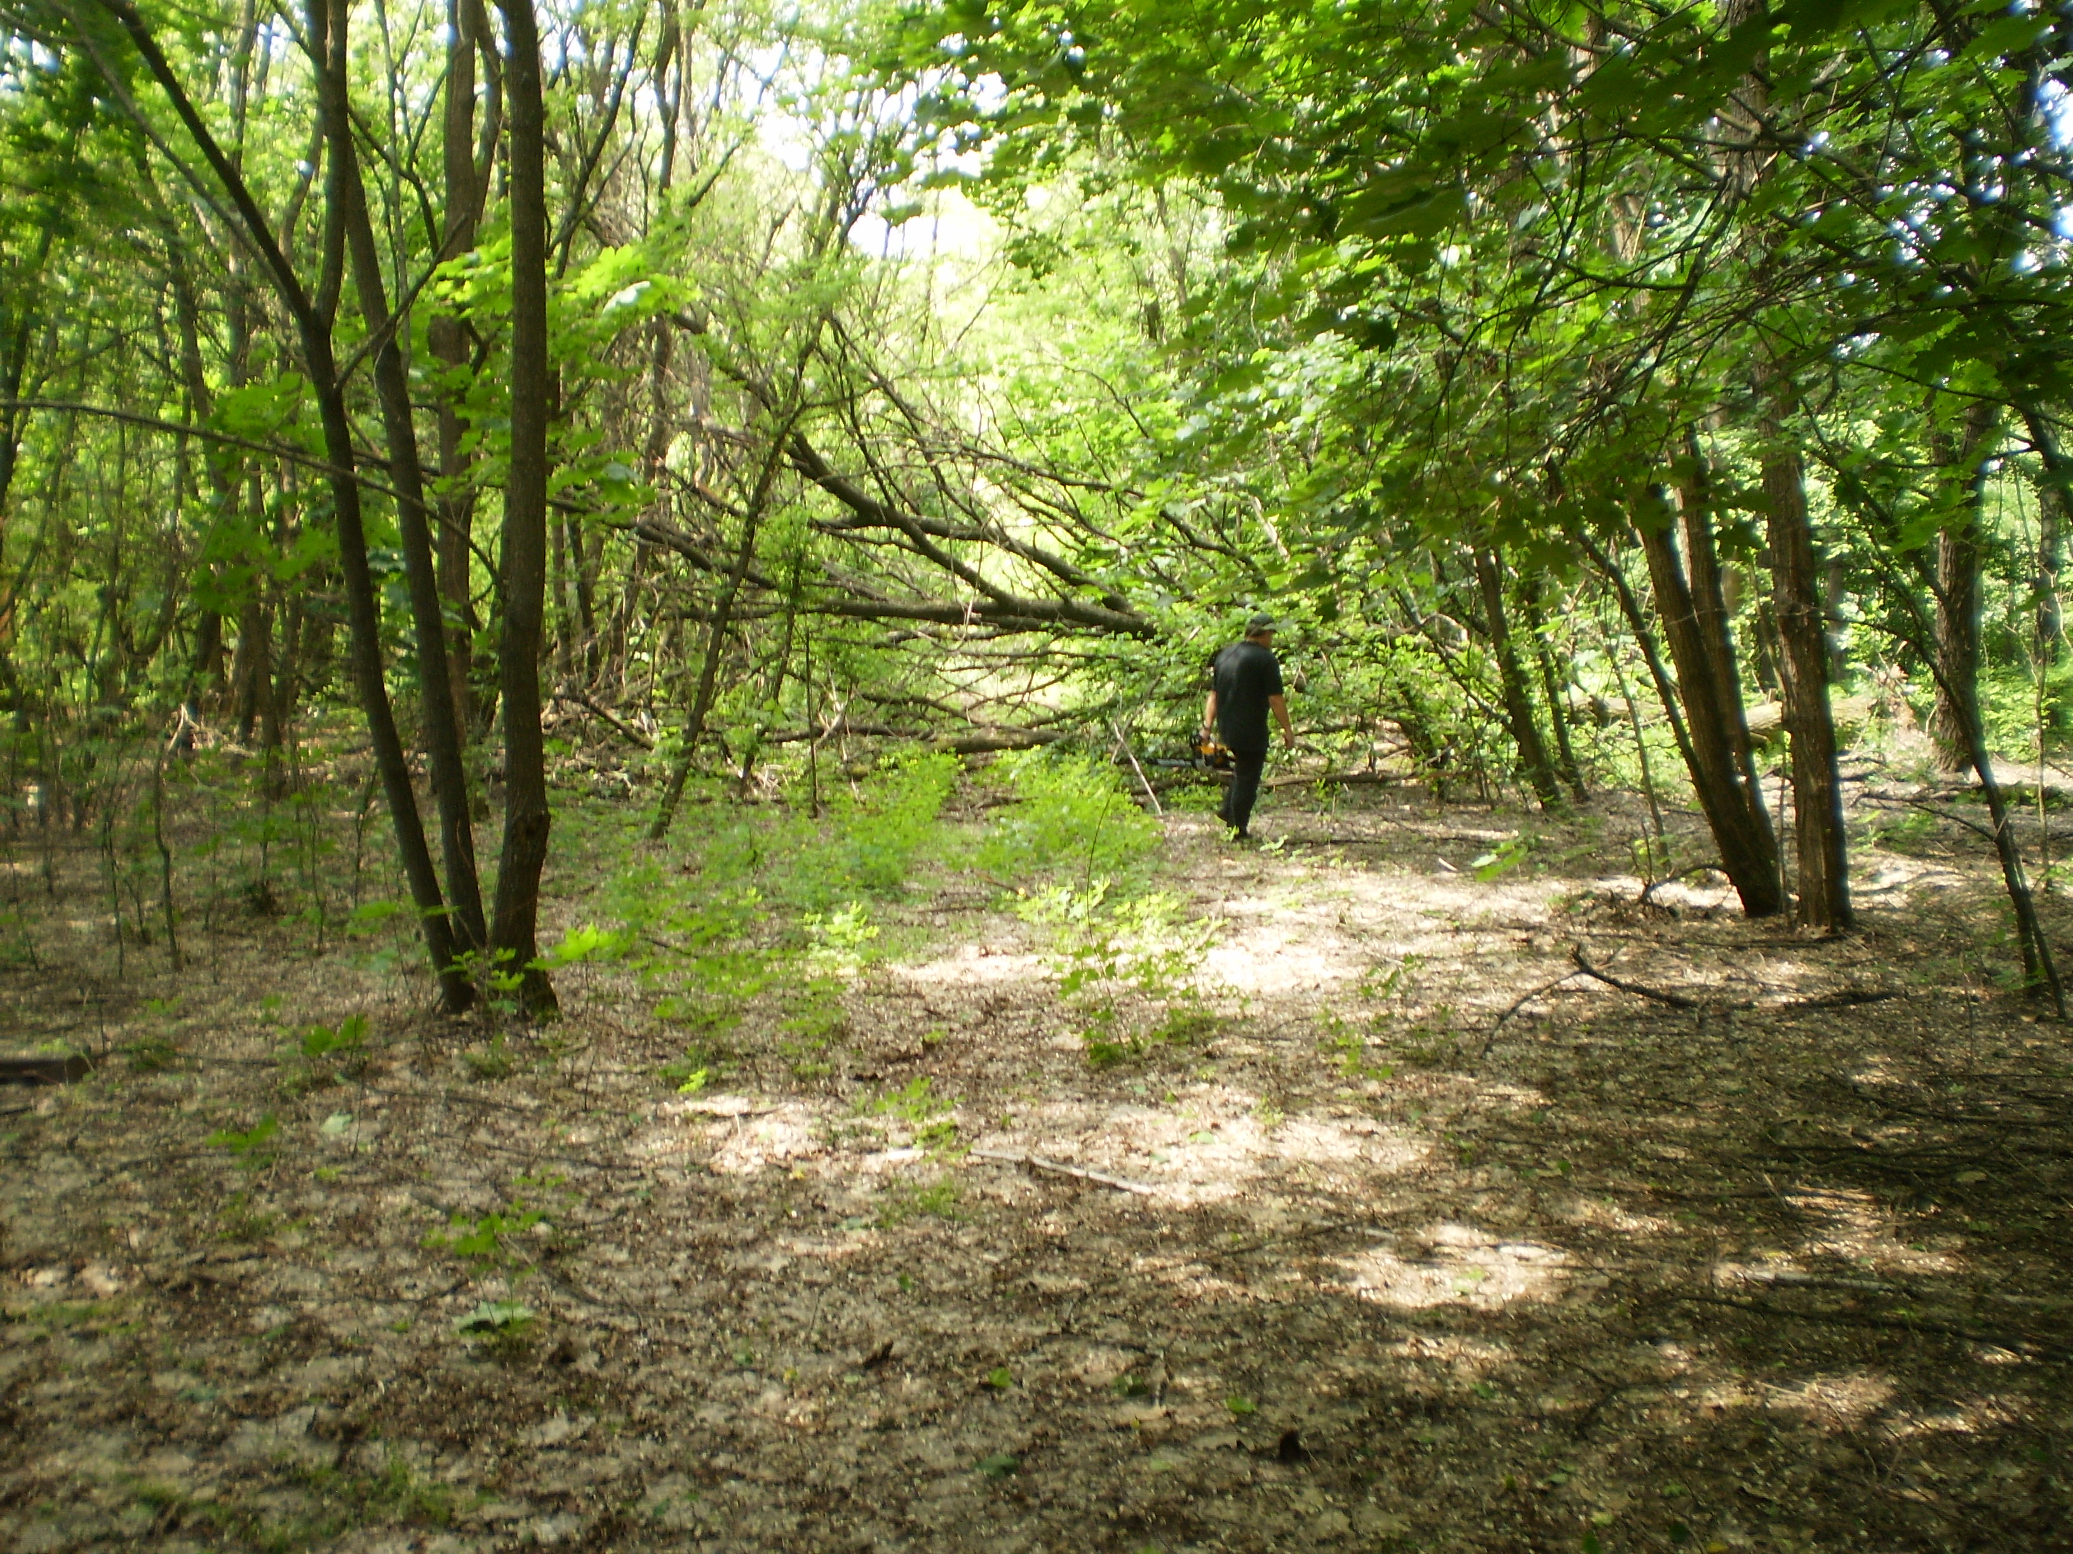
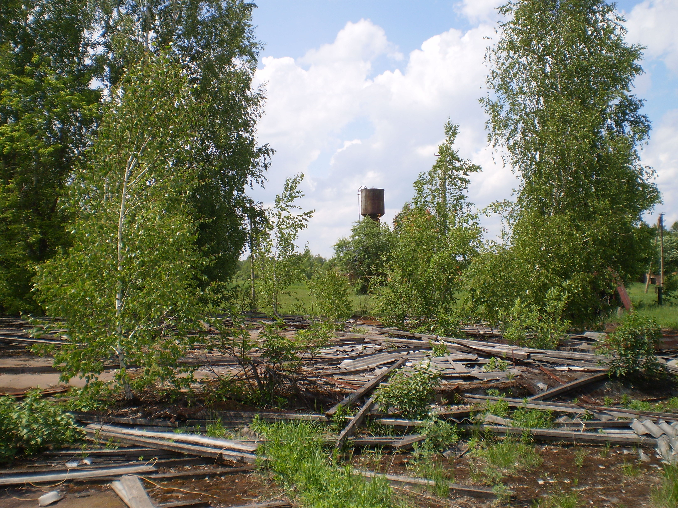
Applications (c. 2015 fires)
Land cover change in Chernobyl
CEZ: 2600 km²
75% boreal forest (pine trees)
25% agricultural land & shrubs
Lack of any forest management
Notes:
These fotos are from our travel to the exclusion zone of Ukraine in 2013 with the group of Anders Moller and Prof Tim Mousseau. So, the area was covered by 53% forest before the disaster and now it’s covered by more than 70%...
The increased contamination lead the official authorities to evacuate these areas. 75% is forest and the rest is agricultural land.
Following up, the limited forest management and activity within the CEZ due to the restricted access resulted in accumulation of firewood and dead plants.
So, there is relatively dense spacing of trees within the forest and also the forest floor is largely litter. You can see in this picture that this is supposed to be a road. And we had to stop and cut falling trees to release the roads.
This fuel structure causes fires to remain close to the ground with relatively short flame lengths and without the means of transitioning to large crown fires except under extreme weather conditions.
However, as mature trees die and more sunlight reaches the forest floor, small young trees and some shade-tolerant trees will grow in these spaces.
This forest succession process may result in more ladder fuels on the forest floor, increasing the risks of large crown fires.

Slide 19
Applications (c. 2015 fires)

Slide 20
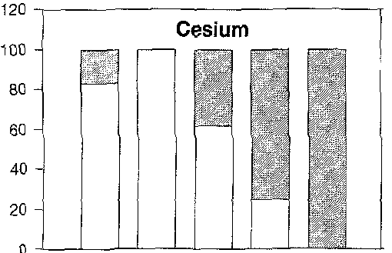

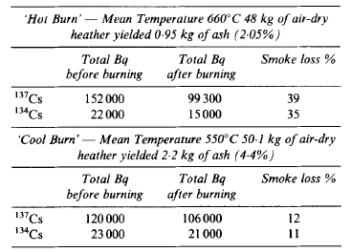
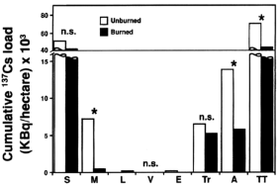
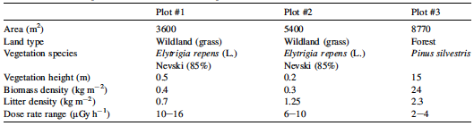
Applications (c. 2015 fires)
Amiro et al. (2006)
Redistribution 20-100%
Horill et al. (1995)
Strode et al. (2012) JGR reports 40-70%
What happens with soil-bound cesium?
Paliouris et al. (1995) >20%
Kashparov et al. (2000) & Yoschenko et al. (2006):
10⁻⁵ – 10⁻⁶ m⁻¹ (Sr, Cs)
10⁻⁶ – 10⁻⁷ m⁻¹ (Pu, Am)
Notes:
Yoschenko et al used 3 natural experimental sites 3 km far from Chern reactor site consisted of 2 grassland sites and 1 forest site. He first measured the dose rates within the sites to evaluate the inhomogeneity of the site in terms of radioactive deposition. He collected samples of soil, natural litter and vegetation from the sites and measured the radionuclide concentrations from several areas of the squares (corners and center) and also the respective concentrations 1 m above ground in order to obtain the radioactive background using IPA samplers. Dry weather facilitated the
intensive fires, and as the wind direction remained stable during the experiments, the well-visible smoke plumes covered the air sampling area and the vertical dimension of the plumes reached up to 10 m. The grassland fires caused the total combustion of the grass In the first experiment (plot #1), the fire front passed 60 m distance in 15 min, while the total period of burning was 30 min. In the second experiment (plot #2), the fire front velocity was higher e the 90 m distance was passed in 13 min, and the total period of burning was again 30 min. The smoke plume arose 30-40 m above the burning area and was then transported over the sampling area. From all the experimental procedure and the measurements of the budget they concluded that the redistribution of cesium after fires is almost 4%
Amiro et al carried out experimental burning of straw (3 times), pine and aspen in an outdoor field of 17 m long and 3 m wide inside a stainless steel pan. They recorded several physicochemical characteristics of fires such as temperature of the fire, moisture of the fuel but did not spiked the fuel. The smoke directly above the tire was sampled to give an indication of relative gaseous and particle emissions using and installation consisted by a tube to collect the plume and filtering instruments to collect the particles. They measured initial concentrations in the fuel, post burnt concentrations in the ash, mass of cesium in the ash, recovery in the ash, cesium in air. They also performed laboratory experiments of burning by collecting straw, wood fuels, edible seaweeds from the market etc… The maximum fire temperature recorded was 600-800 degrees for brief periods up to 2 mins. The wood burns lasted up to 20 min more that straw fires. They also employed gas detectors but cesium was not determined in gaseous form.
Horill et al., 1995 performed experiments for heather burning. Heather has been shown to accumulate greater levels of radiocaesium (Bunzl & Kracke, 1984) than many other upland plants. The fate of radiocaesium in these systems is of interest as heather is the main foodstuff for grouse and, at some times of the year, is grazed by sheep and red deer. There is thus a direct pathway back to man. Heather burning can never be a precise operation. The result will depend on a number of variables including: the density and age of the heather cover; moisture content; time of year - autumn or spring; wind speed and whether the burn was with or against the wind. All these parameters will determine the completeness of the burn, temperatures attained and the condition of the final product, the ash. They collected heather from an area of Scotland which affected intensely by the Chernobyl accident presenting an activity concentration of of 2000 Bq/kg. They used 2 burning regimes to better represent “cool” and “hot” burning. They dried the heather at 85 degrees for 2 weeks and then burnt them at lab conditions. The cool burning was achieved by reducing the air flux through the burning container whereas during the hot burning the air flux was adjusted to the appropriate levels. They analysed the remaining ash by leaching experiments using synthetic rainwater of variable pH. They finally measured the samples with g-spec. They also recorded the temperature of the fire during burning. In the cool burning they found variations between 550-690 degrees, while for the hot burning they found a range of 670-750. They found that 10-40 % of cesium will be lost after a heather fire strongly depending from the temperature. From the leatching experiments they found that an amount of 20 % of cesium could be mobilised by rainwater after a fire depending on the quantity and not on the time of leaching.
for simplicity reasons, we account an emission factor of cesium of 40% both from soil and biomass burning

Slide 21
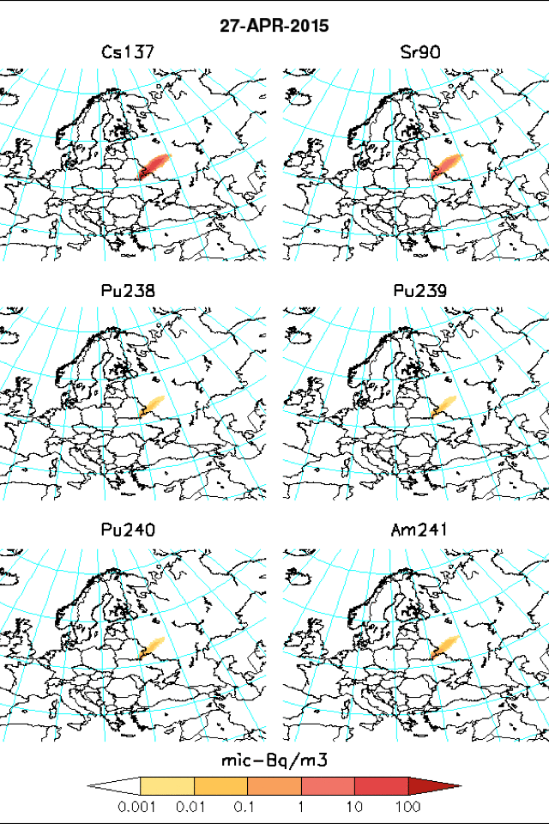
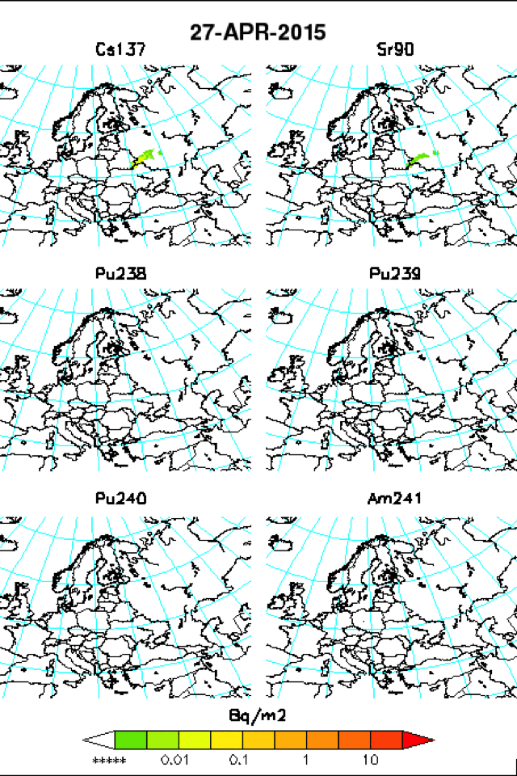
Applications (c. 2015 fires)
Activity concentration
Accumulated deposition
 | Deposition (kBq m⁻²) | Concentration (mBq m⁻³) | Resuspension grid-cell (m⁻¹) | Resuspension 100×100m (m⁻¹)
Cs-137 | 179.8 | 4.05 | 2.2 × 10⁻⁸ | 1.8 × 10⁻⁵
Sr-90 | 46.5 | 1.16 | 2.6 × 10⁻⁸ | 1.8 × 10⁻⁵
Pu-238 | 0.48 | 0.005 | 1.0 × 10⁻⁸ | 8.9 × 10⁻⁶
Pu-239 | 0.38 | 0.004 | 1.0 × 10⁻⁸ | 8.9 × 10⁻⁶
Pu-240 | 0.58 | 0.007 | 1.2 × 10⁻⁸ | 8.9 × 10⁻⁶
Am-241 | 1.82 | 0.021 | 1.2 × 10⁻⁸ | 8.9 × 10⁻⁶

Slide 22


Applications (c. 2015 fires)
Activity concentration
Accumulated deposition
 | Deposition (kBq m⁻²) | Concentration (mBq m⁻³) | Resuspension grid-cell (m⁻¹) | Resuspension 100×100m (m⁻¹)
Cs-137 | 965.5 | 26.1 | 2.7 × 10⁻⁸ | 8.1 × 10⁻⁵
Sr-90 | 96.5 | 2.64 | 2.7 × 10⁻⁸ | 8.1 × 10⁻⁵
Pu-238 | 0.99 | 0.013 | 1.3 × 10⁻⁸ | 4.0 × 10⁻⁵
Pu-239 | 0.80 | 0.010 | 1.2 × 10⁻⁸ | 4.0 × 10⁻⁵
Pu-240 | 1.19 | 0.015 | 1.3 × 10⁻⁸ | 4.0 × 10⁻⁵
Am-241 | 3.78 | 0.048 | 1.3 × 10⁻⁸ | 4.0 × 10⁻⁵

Slide 23
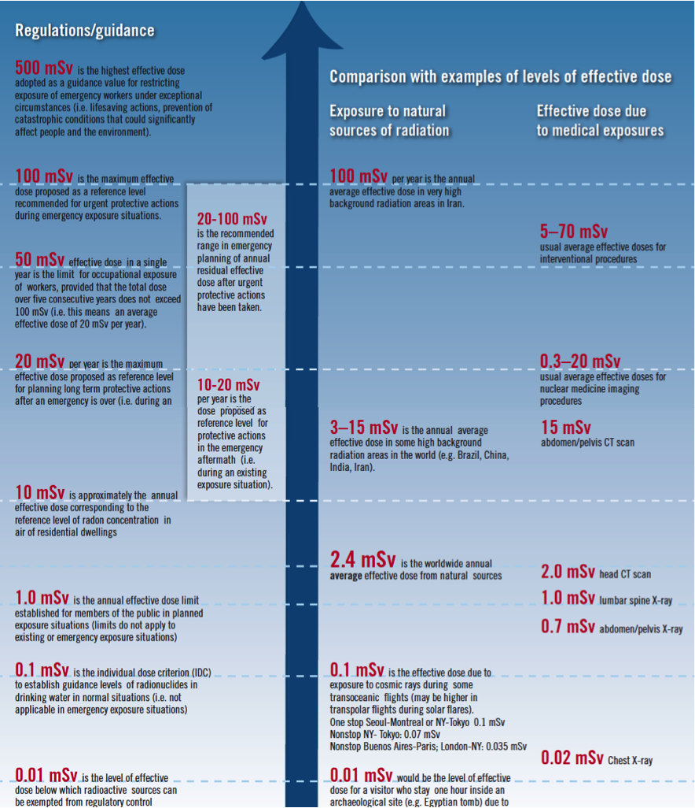
Applications (c. 2015 fires)
External dose from deposition:
External dose from air - immersion:
Internal dose from inhalation:
Data to estimate internal dose from ingestion are not available!!

Slide 24
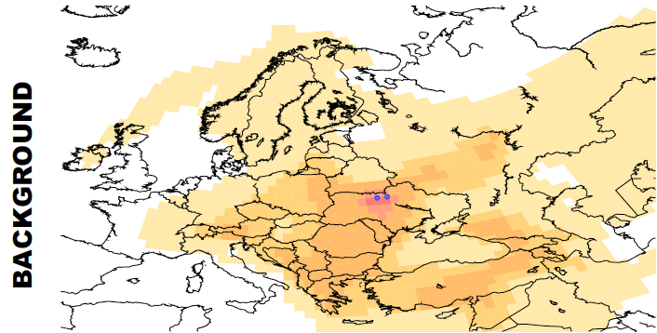
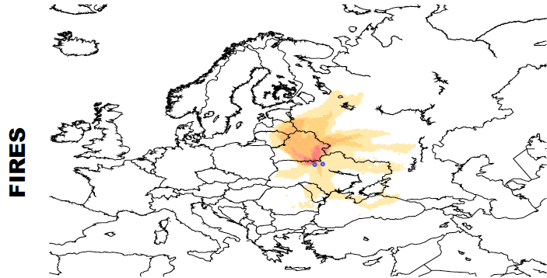
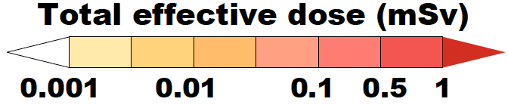
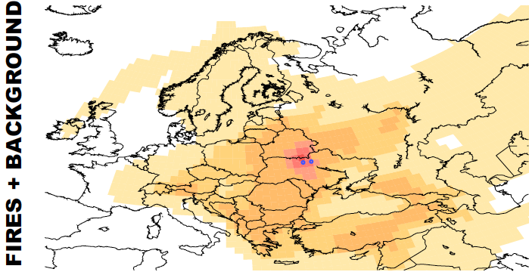
Applications (c. 2015 fires)

Slide 25
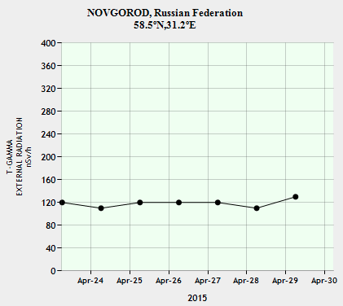
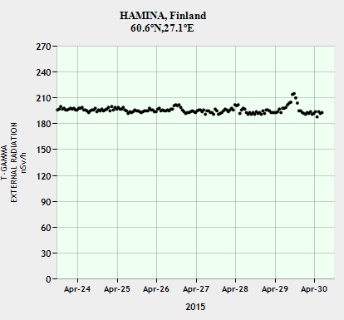
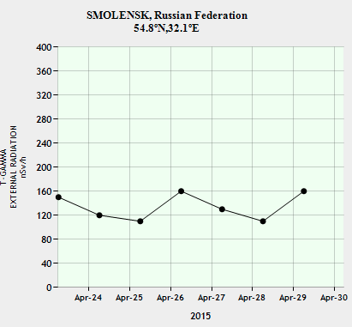
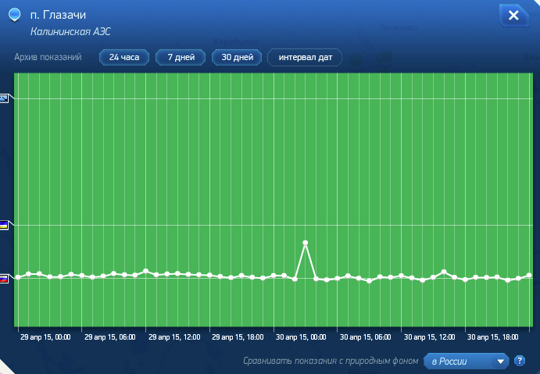
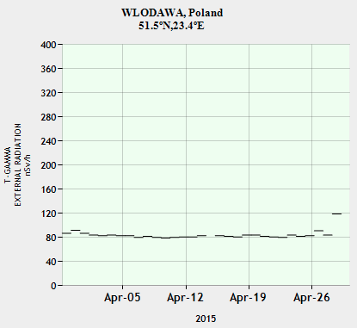
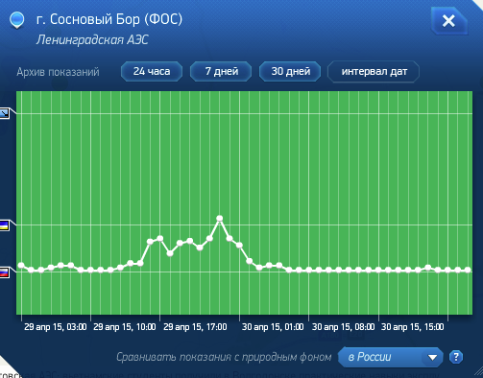
Applications (c. 2015 fires)
https://remon.jrc.ec.europa.eu
http://www.russianatom.ru

Slide 26
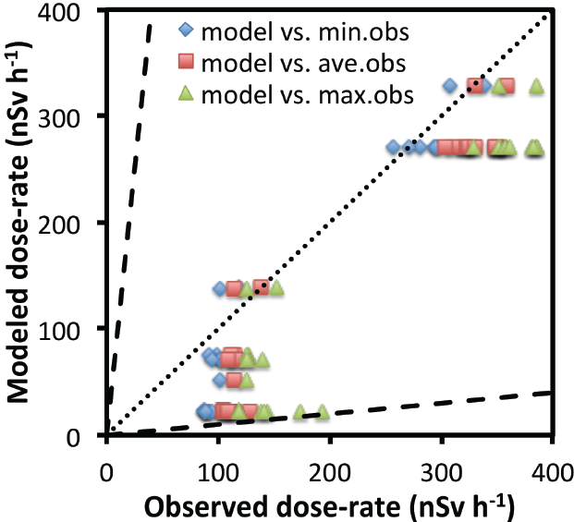
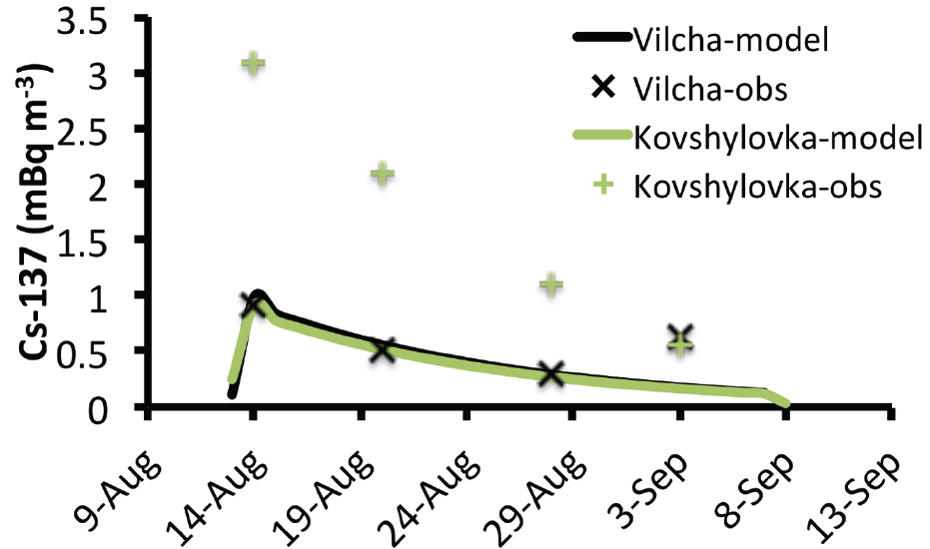
Applications (c. 2015 fires)

Slide 27
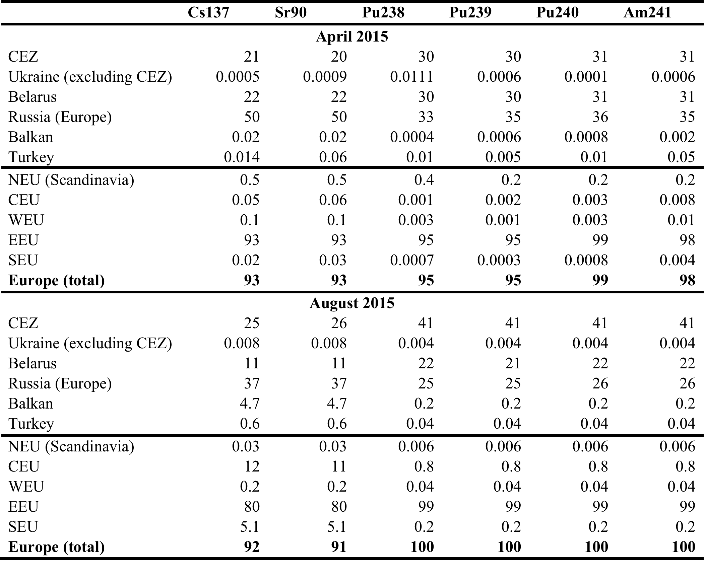
Applications (c. 2015 fires)

Slide 28
Who is going to benefit from the project?
Scientists
  Mathematicians/Statisticians getting new inspiration from real world application
  Environmental scientists getting new software tools (Flexpart, inversion methods)
Ph.D. students, postdocs, Environmental protection authorities
  Radiation protection institutes (SÚRO, BfS, CTBTO),
Research institutions
  New equipment, new research ideas and future collaboration

Slide 29
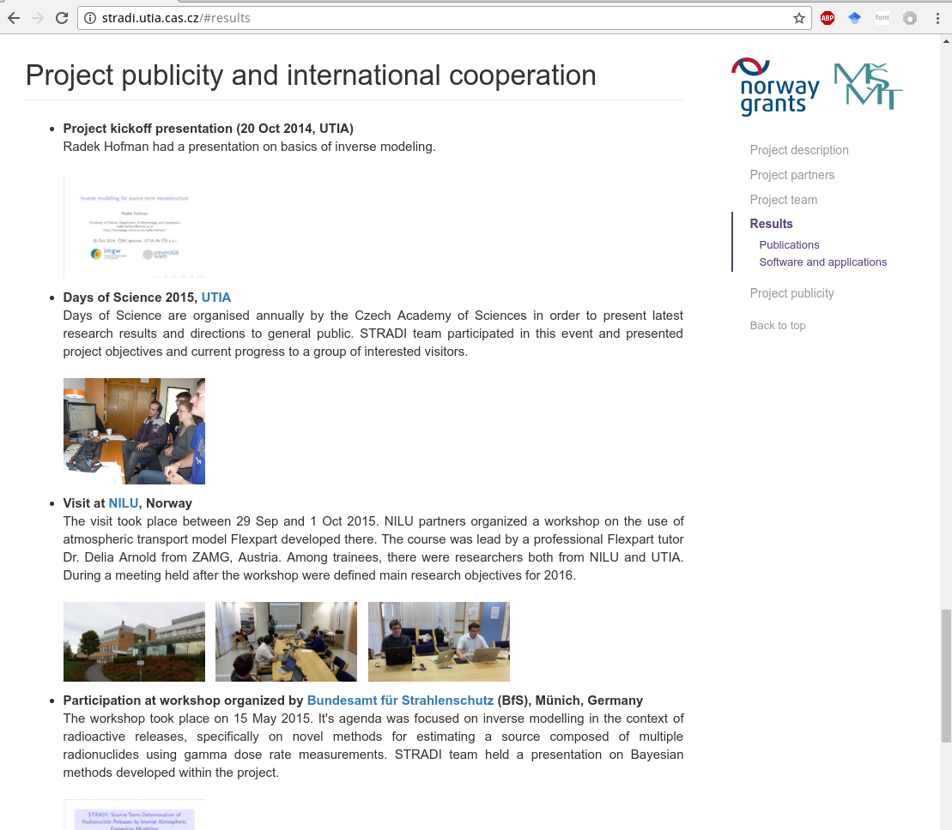
Thank you very much! Tusen takk!
Speakers :
Doc. Ing. Václav Šmídl, Ph.D.
Institute of Information Theory and Automation, Czech Academy of Sciences
Department of Adaptive Systems
Nikolaos Evangeliou, Ph.D.
Norwegian Institute of Air Research, Kjeller, Norway
stradi.utia.cas.cz
smidl@utia.cas.cz

